Slide 1


Slide 2




D0n’t D0 ill3gal Sh1t !

Slide 3

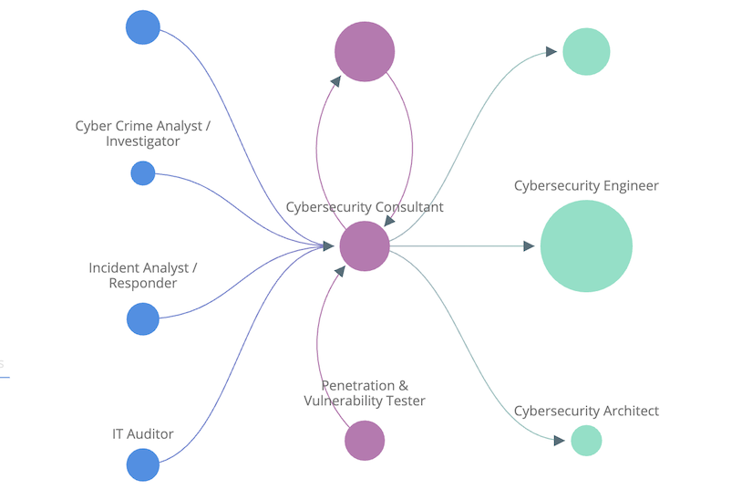
What do you want?
Maybe?

Slide 4

What do you want?
Try new Things
Take part in events
Online courses
(TryHackMe/HackTheBox/Others)
Placement
Networking with People

Slide 5

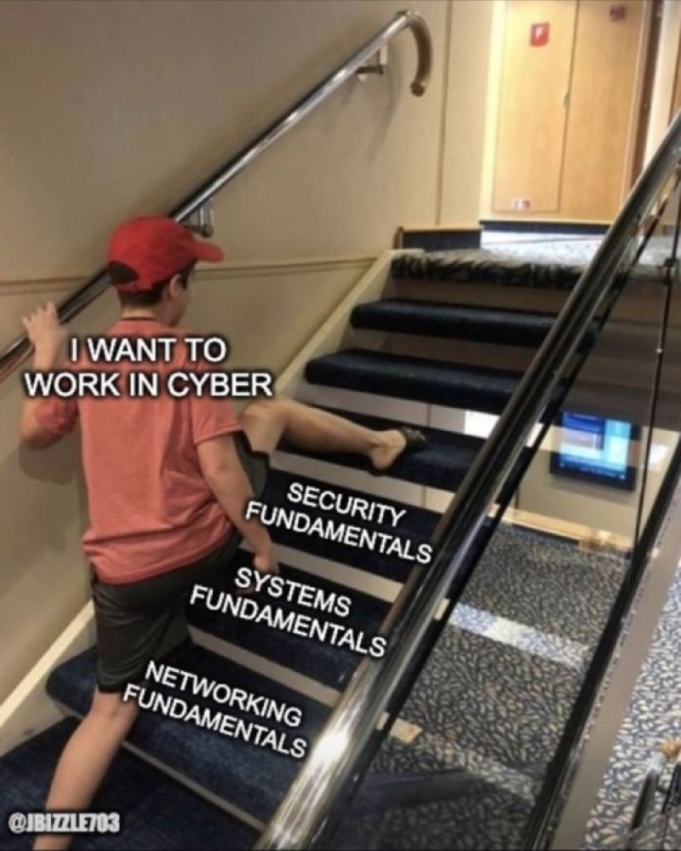

Slide 6

Avenues of Cyber Jobs
Dilan Approach
Orlin Approach
Adam Approach
Making Sh*t
Secure Software Dev
Security Architect
Designing Hacking Tools
Breaking Sh*t
Physical Security Tester
Penetration Tester
Security Researcher
Maintaining Sh*t
Security Analyst
GRC Advisor

Slide 7
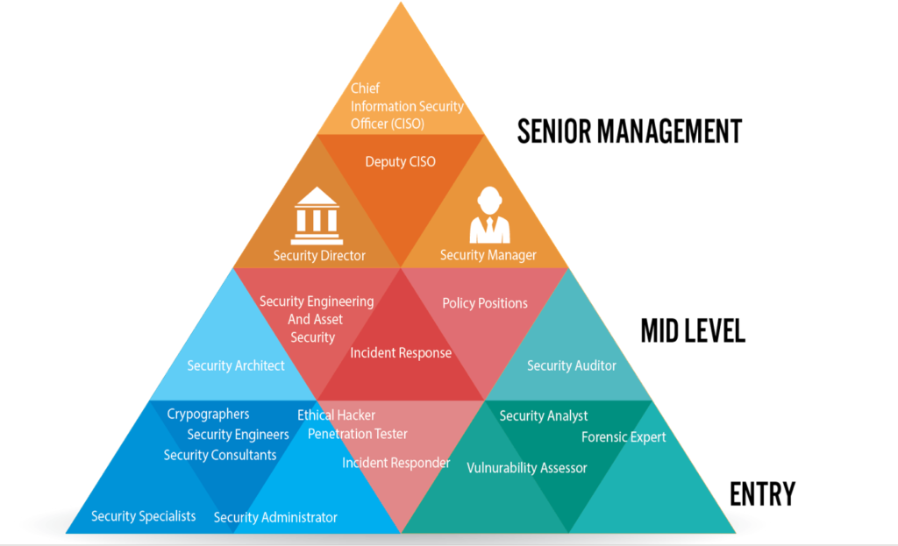

Slide 8
What is a Placement?
A chance to go out into industry and put university knowledge to use within a business environment.
Opportunity to gain industry experience before leaving university.
Provides the opportunity to test fit a job to see whether it is for you.

Slide 9
Why Bother?
Industry experience
Looks fantastic on CV
Hands on skill experience
Networking
Counts towards degree (for some courses)

Slide 10

Year Vs Summer Placement
Year Placement
Summer Placement
Longer period in the job
More chances to move around in the job
Better understanding of your working area
Doesn’t take an extra year to complete uni
Smaller projects with higher chance of completion
Keeps you busy during those long summer weeks without uni work?

Slide 11
Cover Letters
Writing a cover letter:
Who are you
What qualifies you for the position
Why do you want the job
Done.
Notes:
Joe, Joey & Me

Slide 12
CV
Keep the information relevant
Avoid too much detail in favour of summaries
Key skills/Qualifications/Achievements
Free certifications, TryHackMe & CTF certificates
Education
A-level grades & University module marks (or overall year marks)
Sell yourself

Slide 13
Interviews
Know the company
The good, the bad and definitely the ugly
Common interview questions
Why do you want the job? Why do you want to work here? Where do you see yourself in *insert time period*?
Ask questions
Dress code, team dynamics, in office hours
Ask for time

Slide 14
Possible Questions
You see a login at 1900 from England and then one from 1905 from France on the same user account. How do you verify if this is a true positive and what remedial actions do you take?
The scope for your project (banking application) has been halved, out of a given feature set what do you remove in order to still hit your deadline?

Slide 15
Assessment Centers & Tests
Assessment Centers
Psychometric Tests
In person held by the company
Can be a series of tests often finished with an interview
Aim is to see how you work as part of a team
Covers similar ground to a psychometric test
Used to assess intelligence, reasoning ability and personality
Held online
Questions can seem weird and unrelated
Its not all about what you think the employer wants.

Slide 16

Your turn!

